Slide 1
Death by Numbers Network Analysis and London’s Bills of Mortality
Jessica Otis
March 22, 2018
Renaissance Society of America Annual Meeting
@jotis13

Slide 2
November 5, 1665: “Up, and after being trimmed, by boate to the Cockepitt, where I heard the Duke of Albemarle’s chaplain make a simple sermon. Among other things, reproaching the imperfection of humane learning, he cried – “All our physicians can’t tell what an ague is, and all our Arithmetique is not able to number the days of a man” – which, God knows, is not the fault of arithmetique but that our understandings reach not that thing.”
Samuel Pepys, The Diary of Samuel Pepys, eds. Robert Latham and William Matthews (Berkeley: University of California Press, 1972), 6:289.
@jotis13

Slide 3
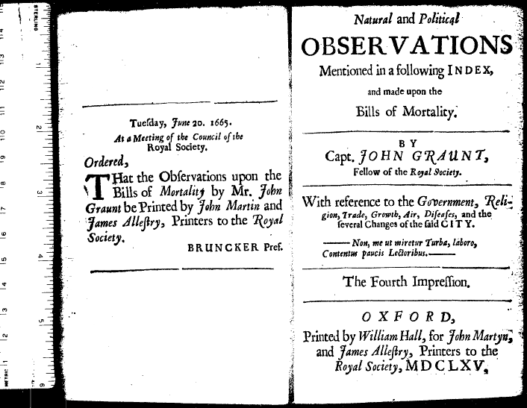
Our understandings reach not that thing… yet!
@jotis13

Slide 4
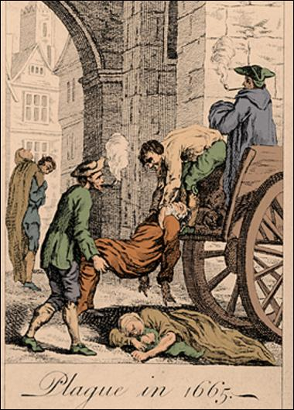
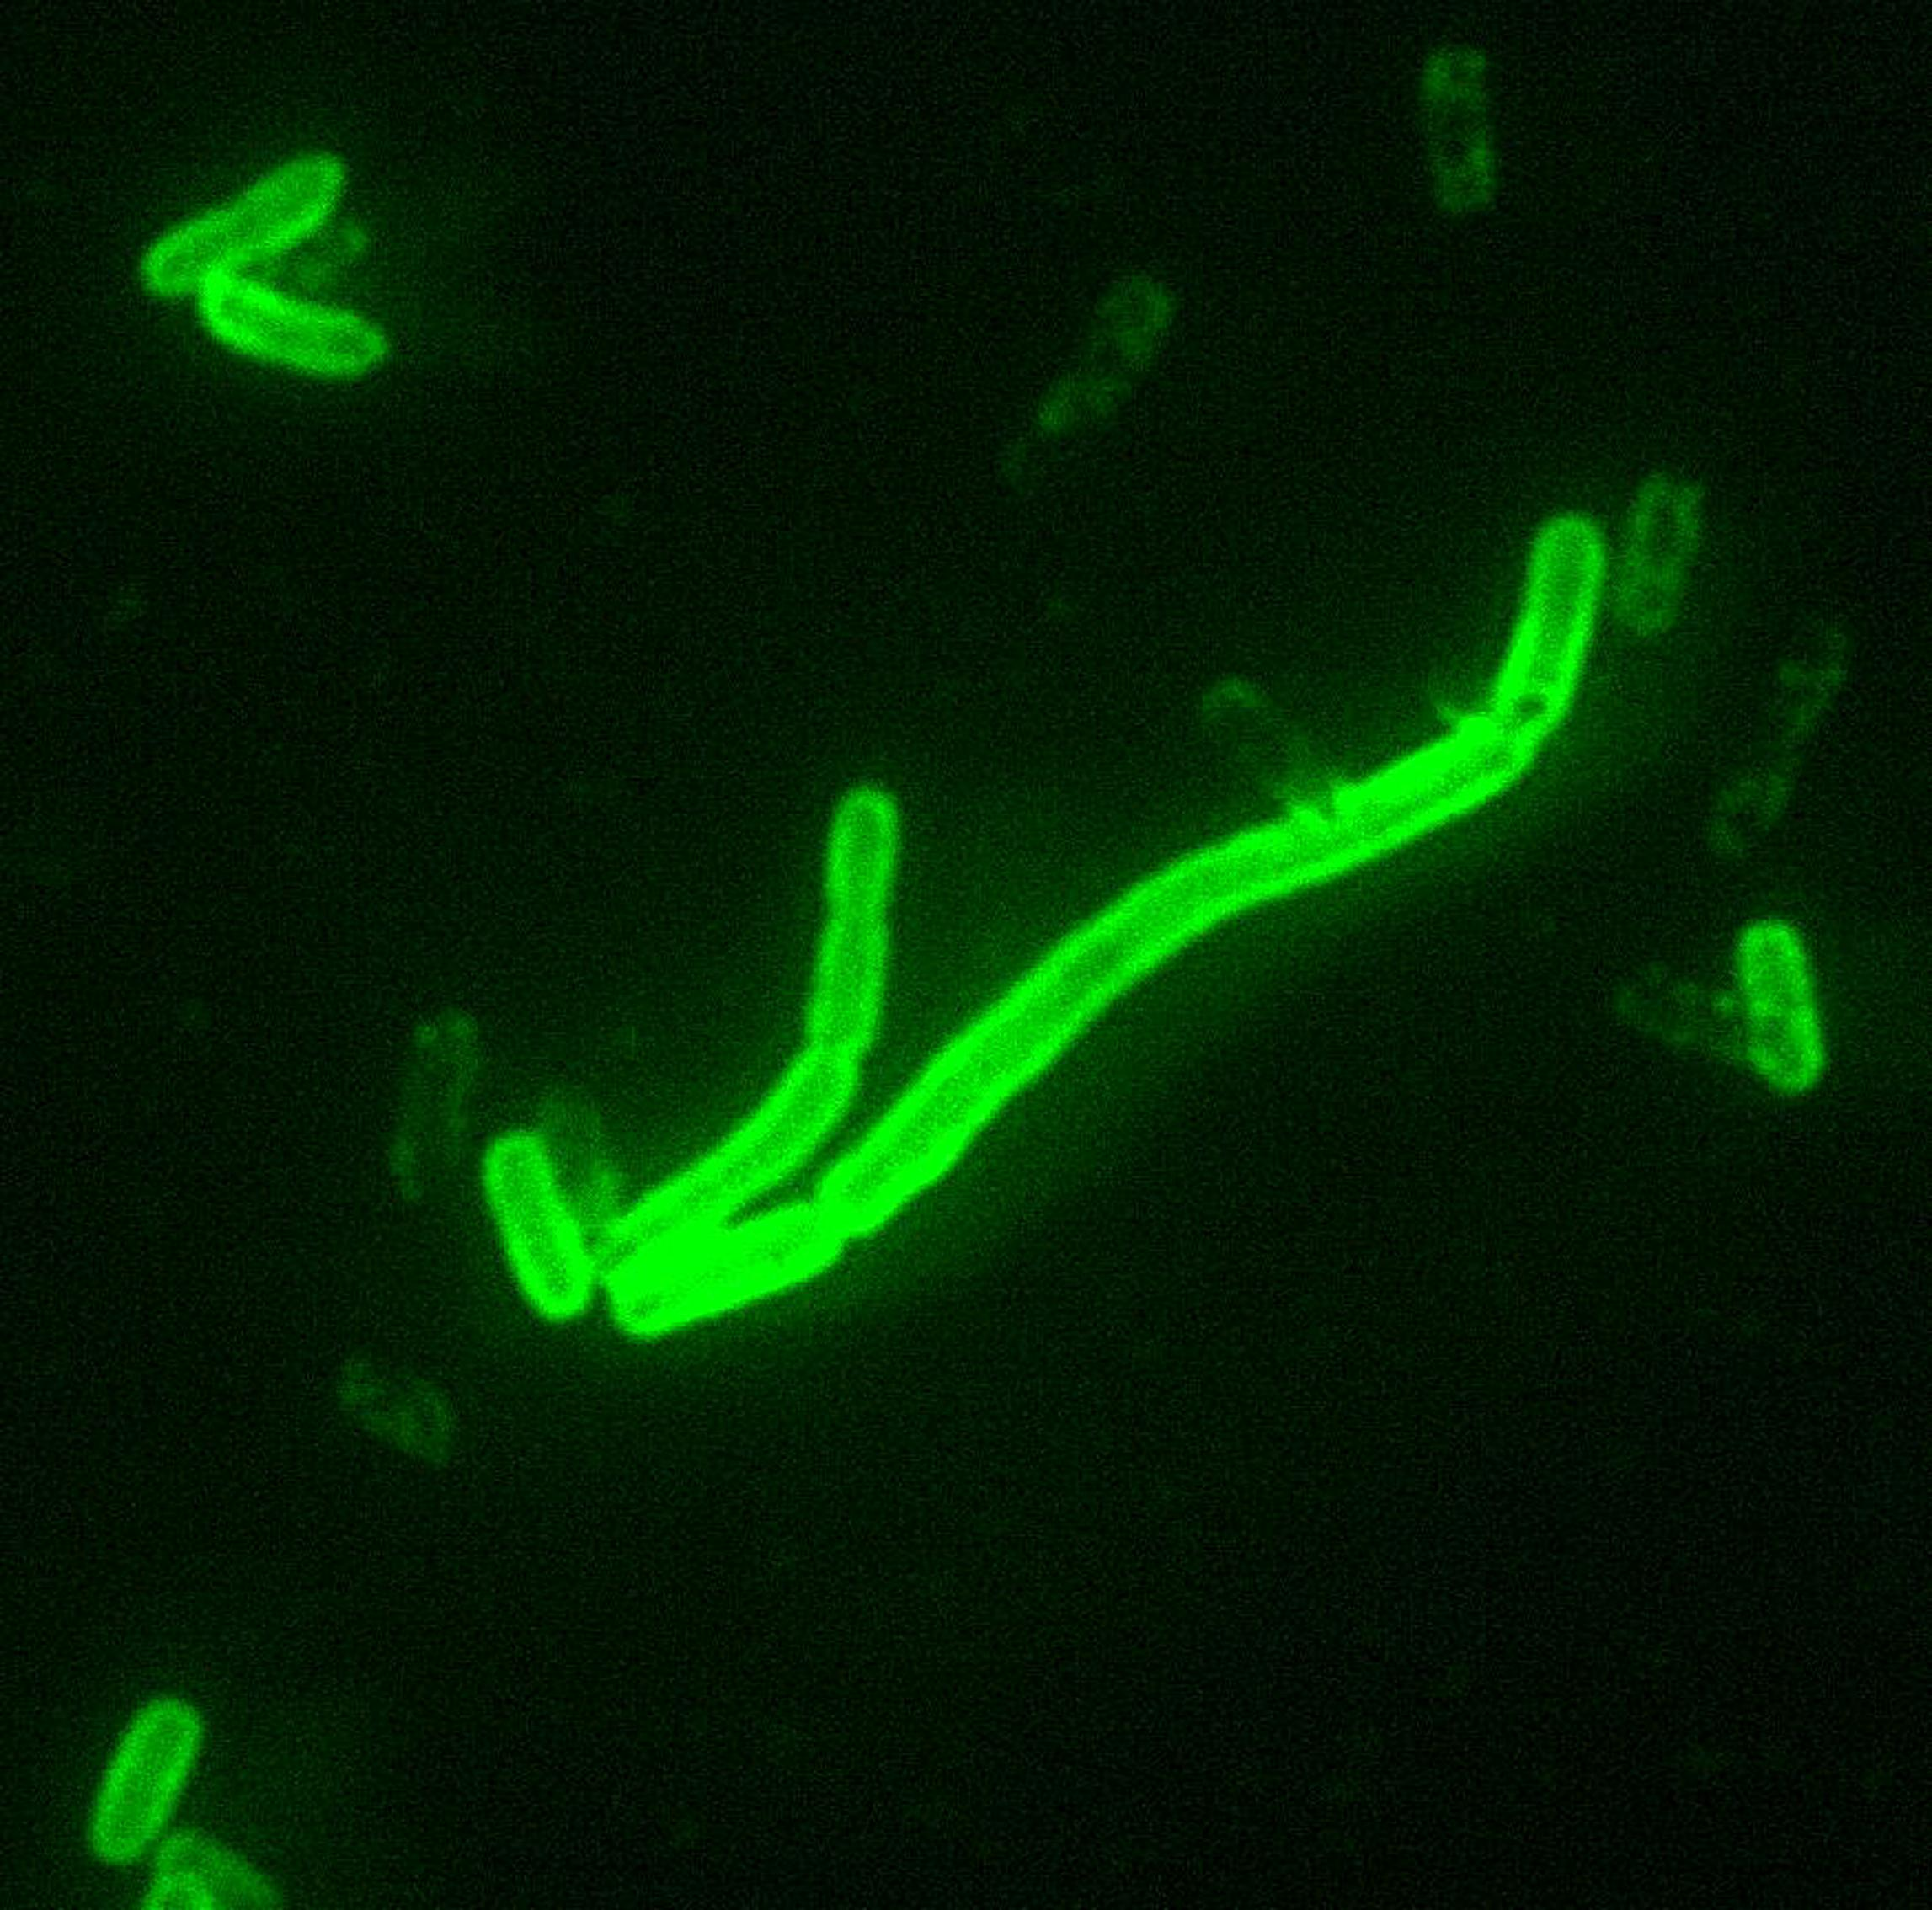
Bubonic Plague
@jotis13

Slide 5
Plague in 17th–Century London
Major Outbreaks
1603-11
1625-26
1636-48
1665-6(ish)
Highest Mortality Years
1603: 25,045
1625: 26,350
1636: 10,400
1665: 55,797
@jotis13

Slide 6
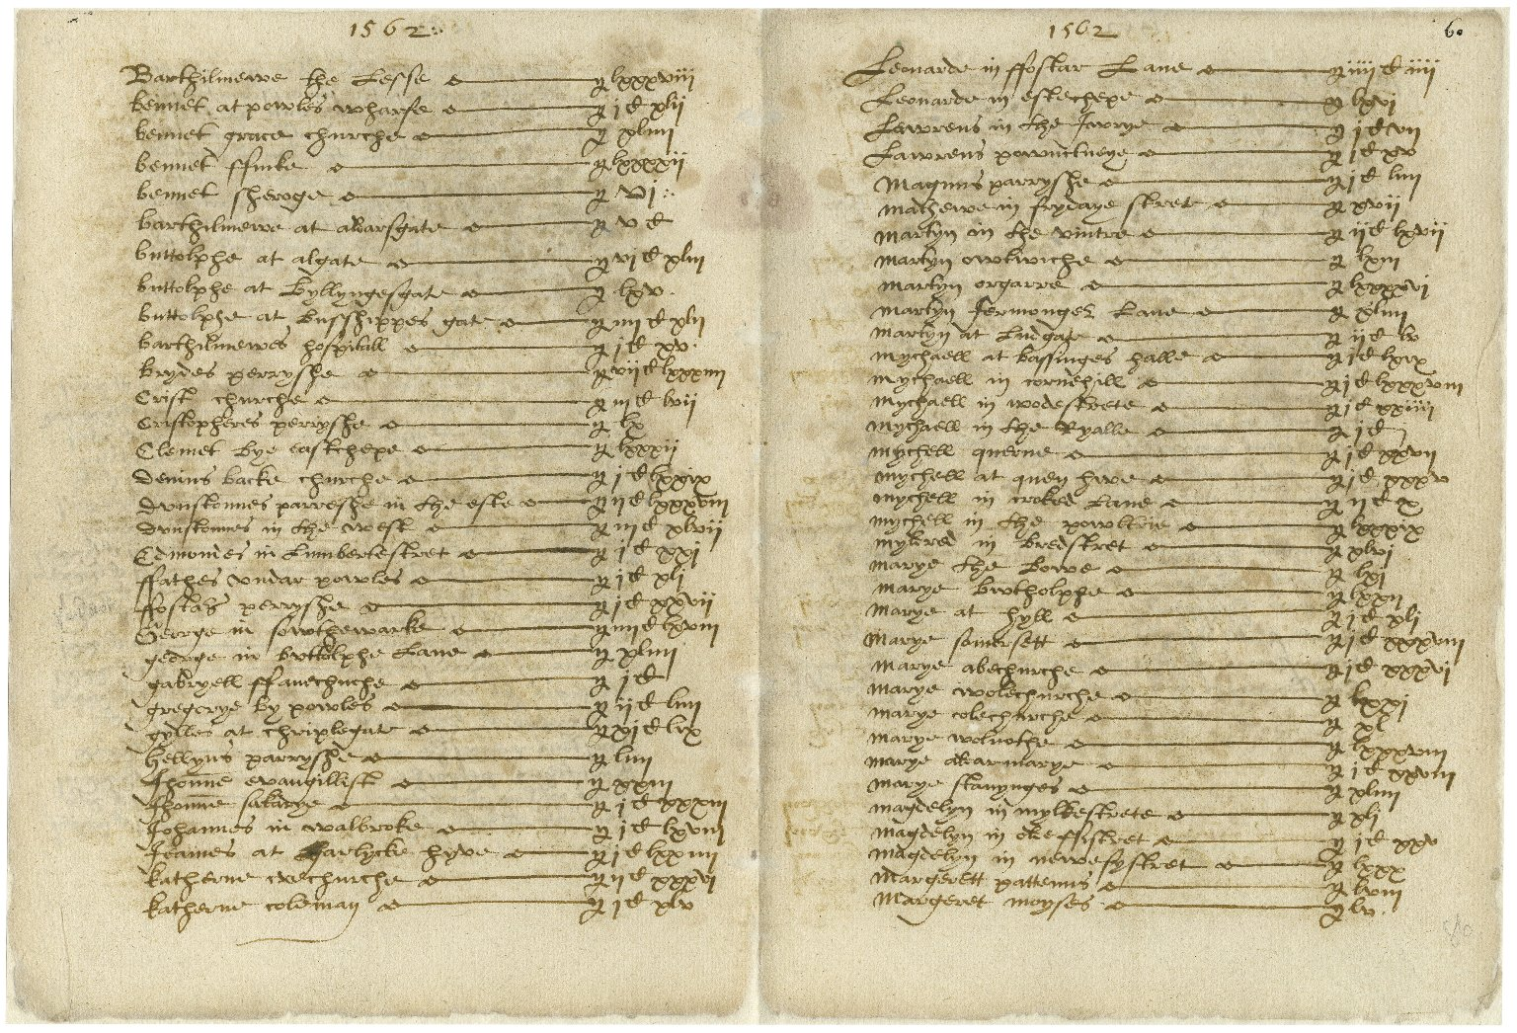
London Record-Keeping in the 16th Century
@jotis13

Slide 7
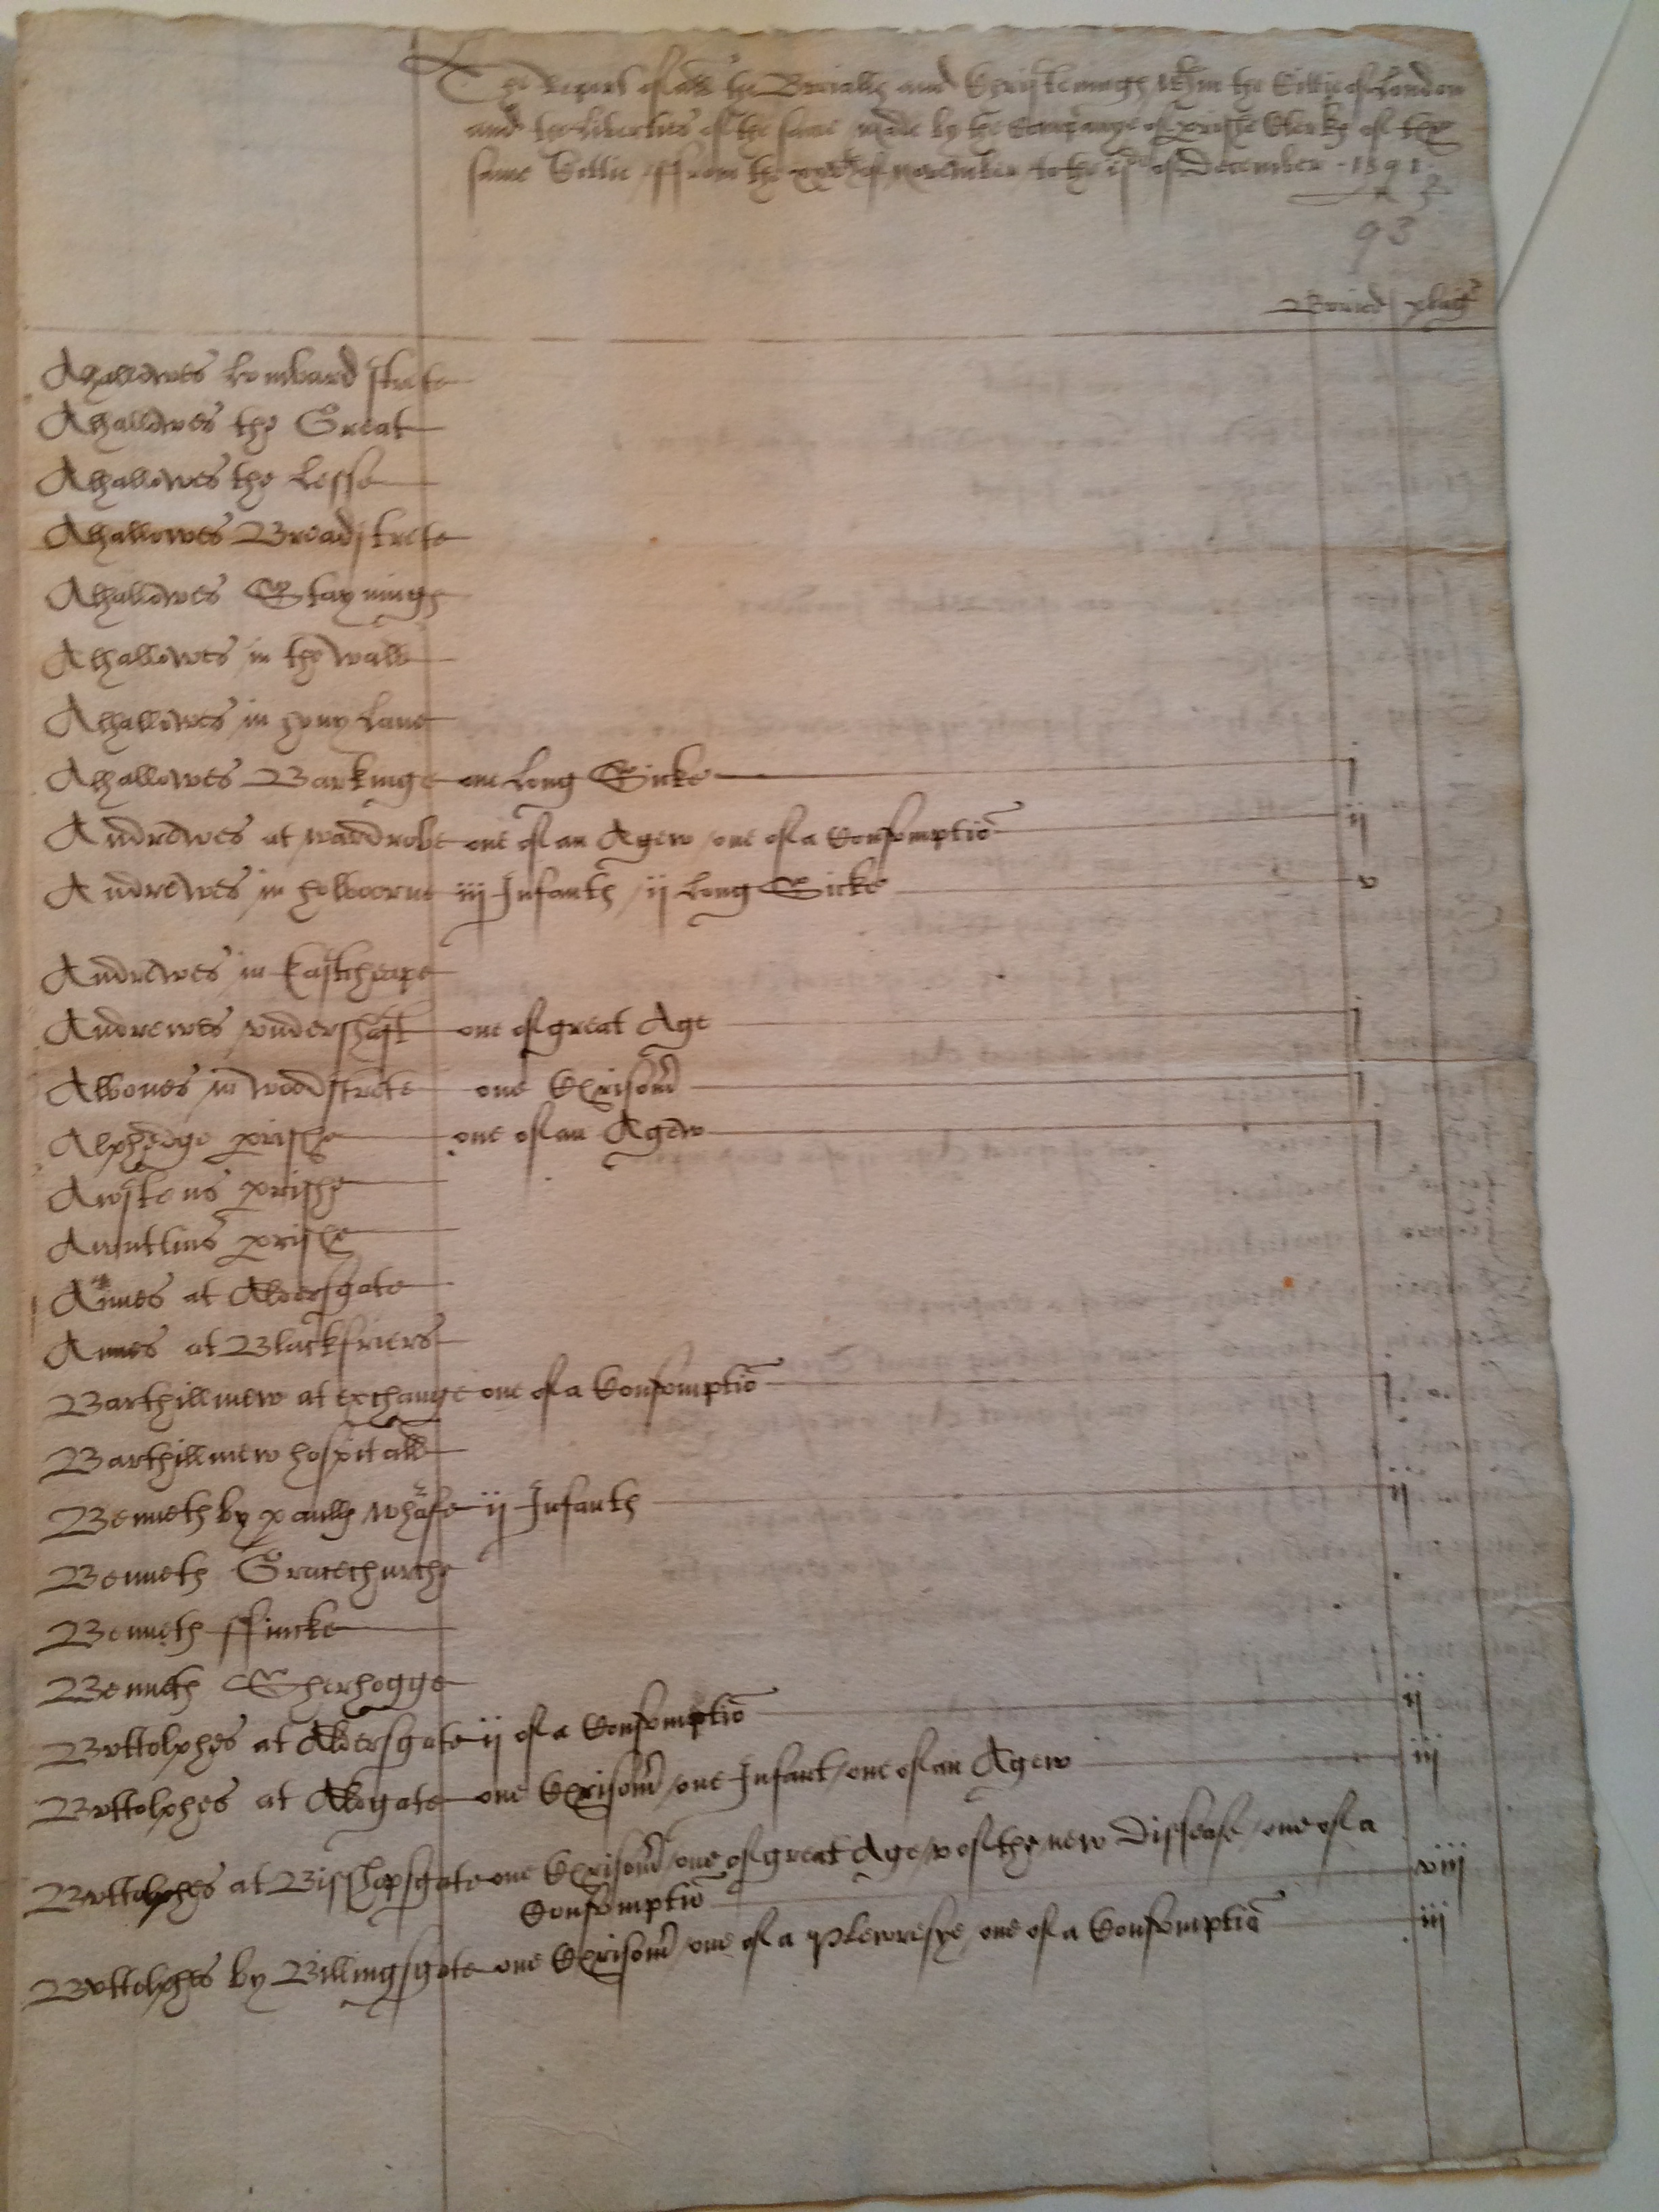
Reporting to the Monarch
each of London’s parish clerks submitted weekly death tolls, with cause of death, to Company
information compiled into a single document
presented weekly to the monarch (or servants)
long, detailed reports
@jotis13

Slide 8
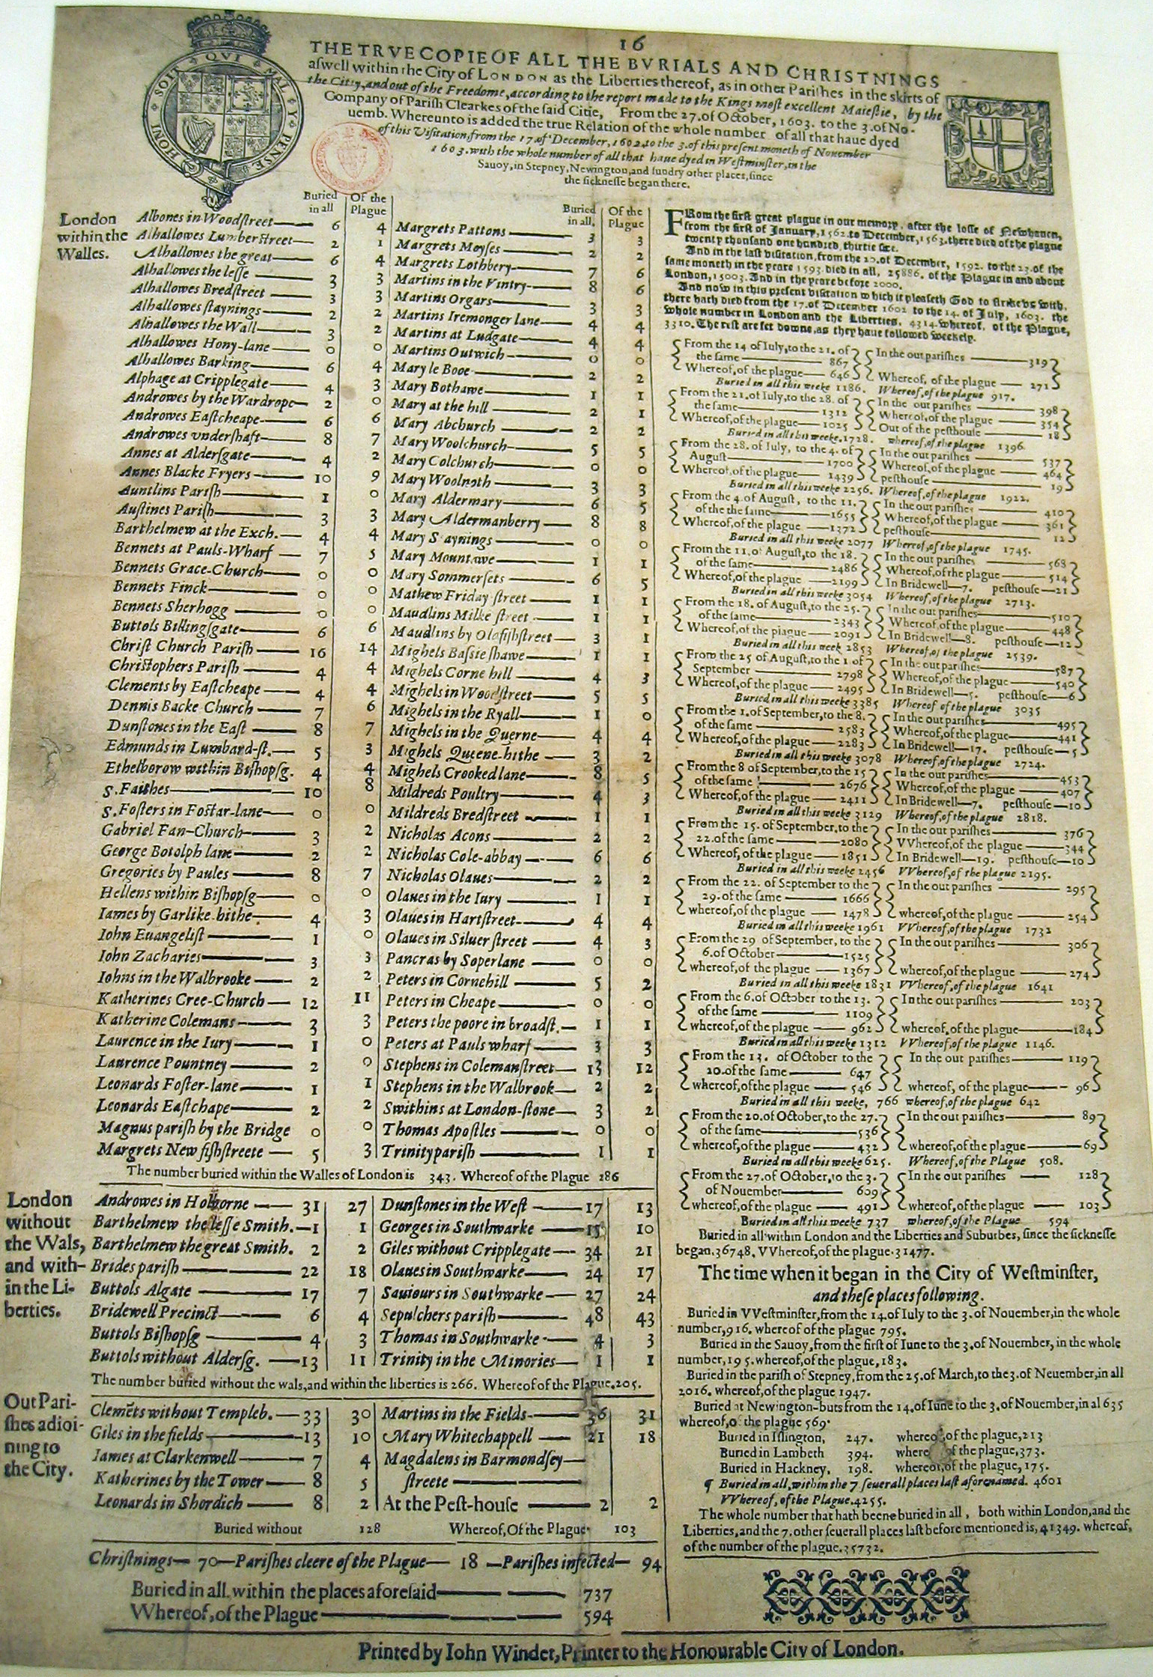
Weekly London Bill of Mortality, 1603 Epidemic
including:
parish-by-parish breakdown of deaths
total deaths vs. plague deaths
sum total of all parish deaths
sum totals from previous weekly Bills
sum totals of all weekly Bills
@jotis13

Slide 9
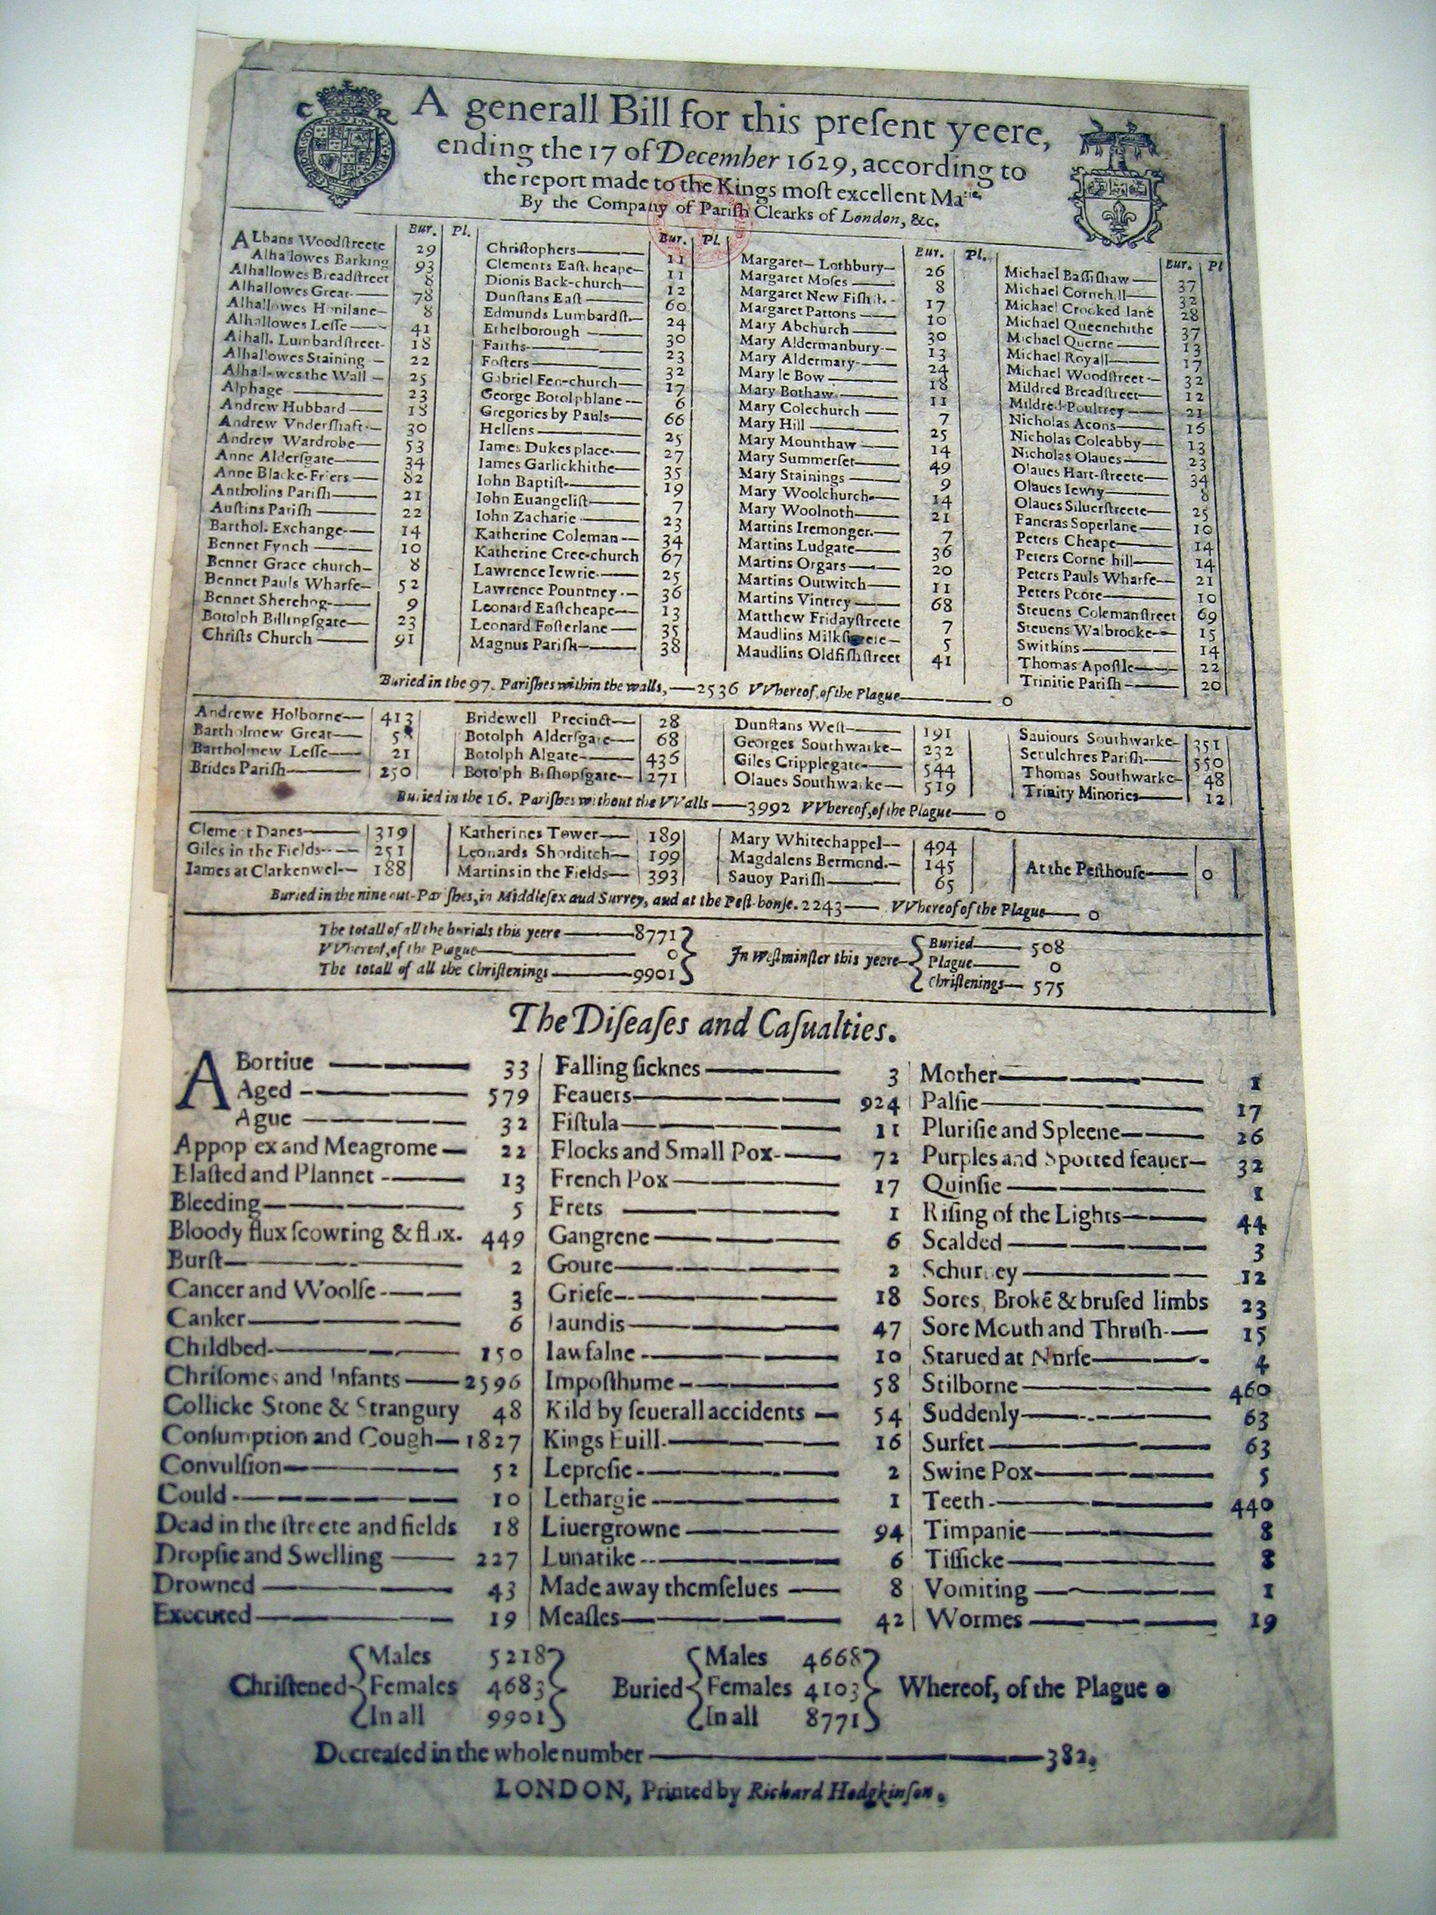
General London Bill of Mortality, non-plague year
includes:
parish-by-parish breakdown of deaths
total deaths vs. plague deaths
sum total of deaths
christenings and burials, subdivided by gender
causes of death
@jotis13

Slide 10
“They haue beene and are very diligent in enquiring after the weekly Bils of mortality, and they that could first obtaine the Bill from their Parish Clarks haue acknowledged to be most beholden vnto them… if they haue found an increase of the number, haue they humbled themselues in Prayer, endeauouring to depart from their sinnes, & to trauaile to this Towre-Royall, in the sequell, for safetie? Surely, no, few or none haue so done: the increase happ’ly hath deiected them, made them murmure, and proiect to flee to their Country-houses here or there, and peraduenture to send beforehand their Wiues, Children, and Houshold-stuffe.”
J. D. Salomons Pest-Hovse, Or Tovvre-Royall (London: Thomas Harper, 1630), A4v.
@jotis13

Slide 11
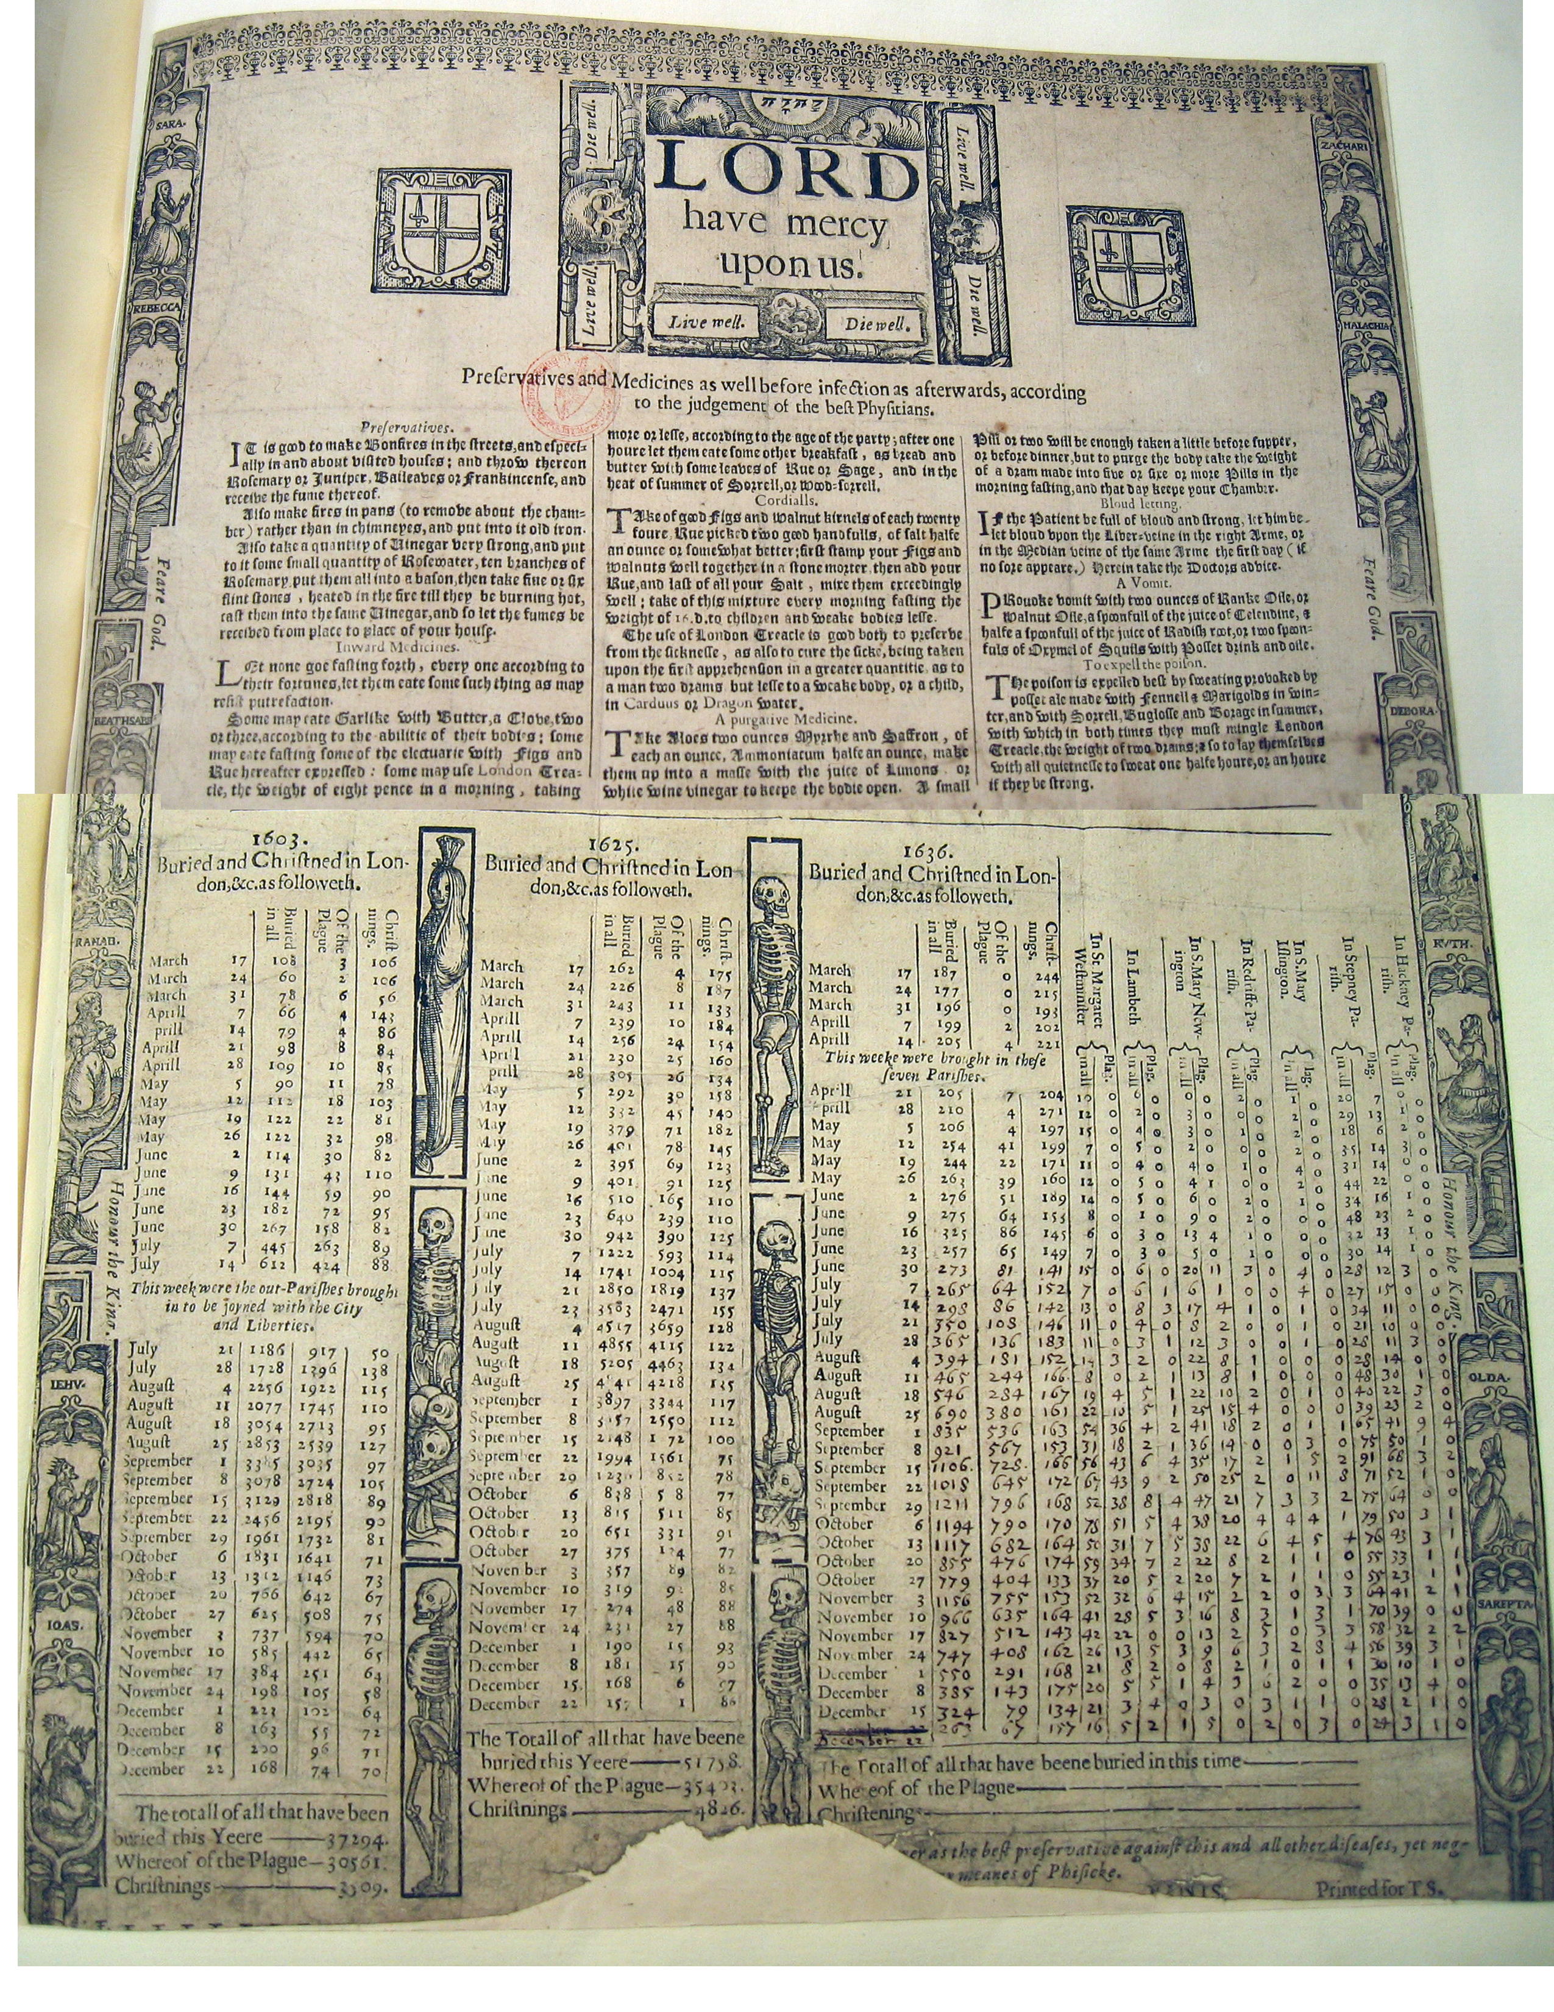
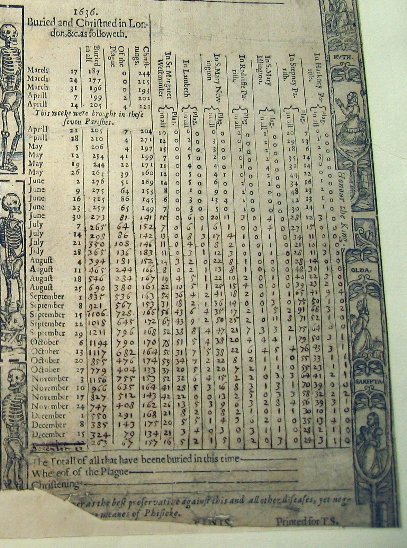
1636 Plague Broadside

Slide 12
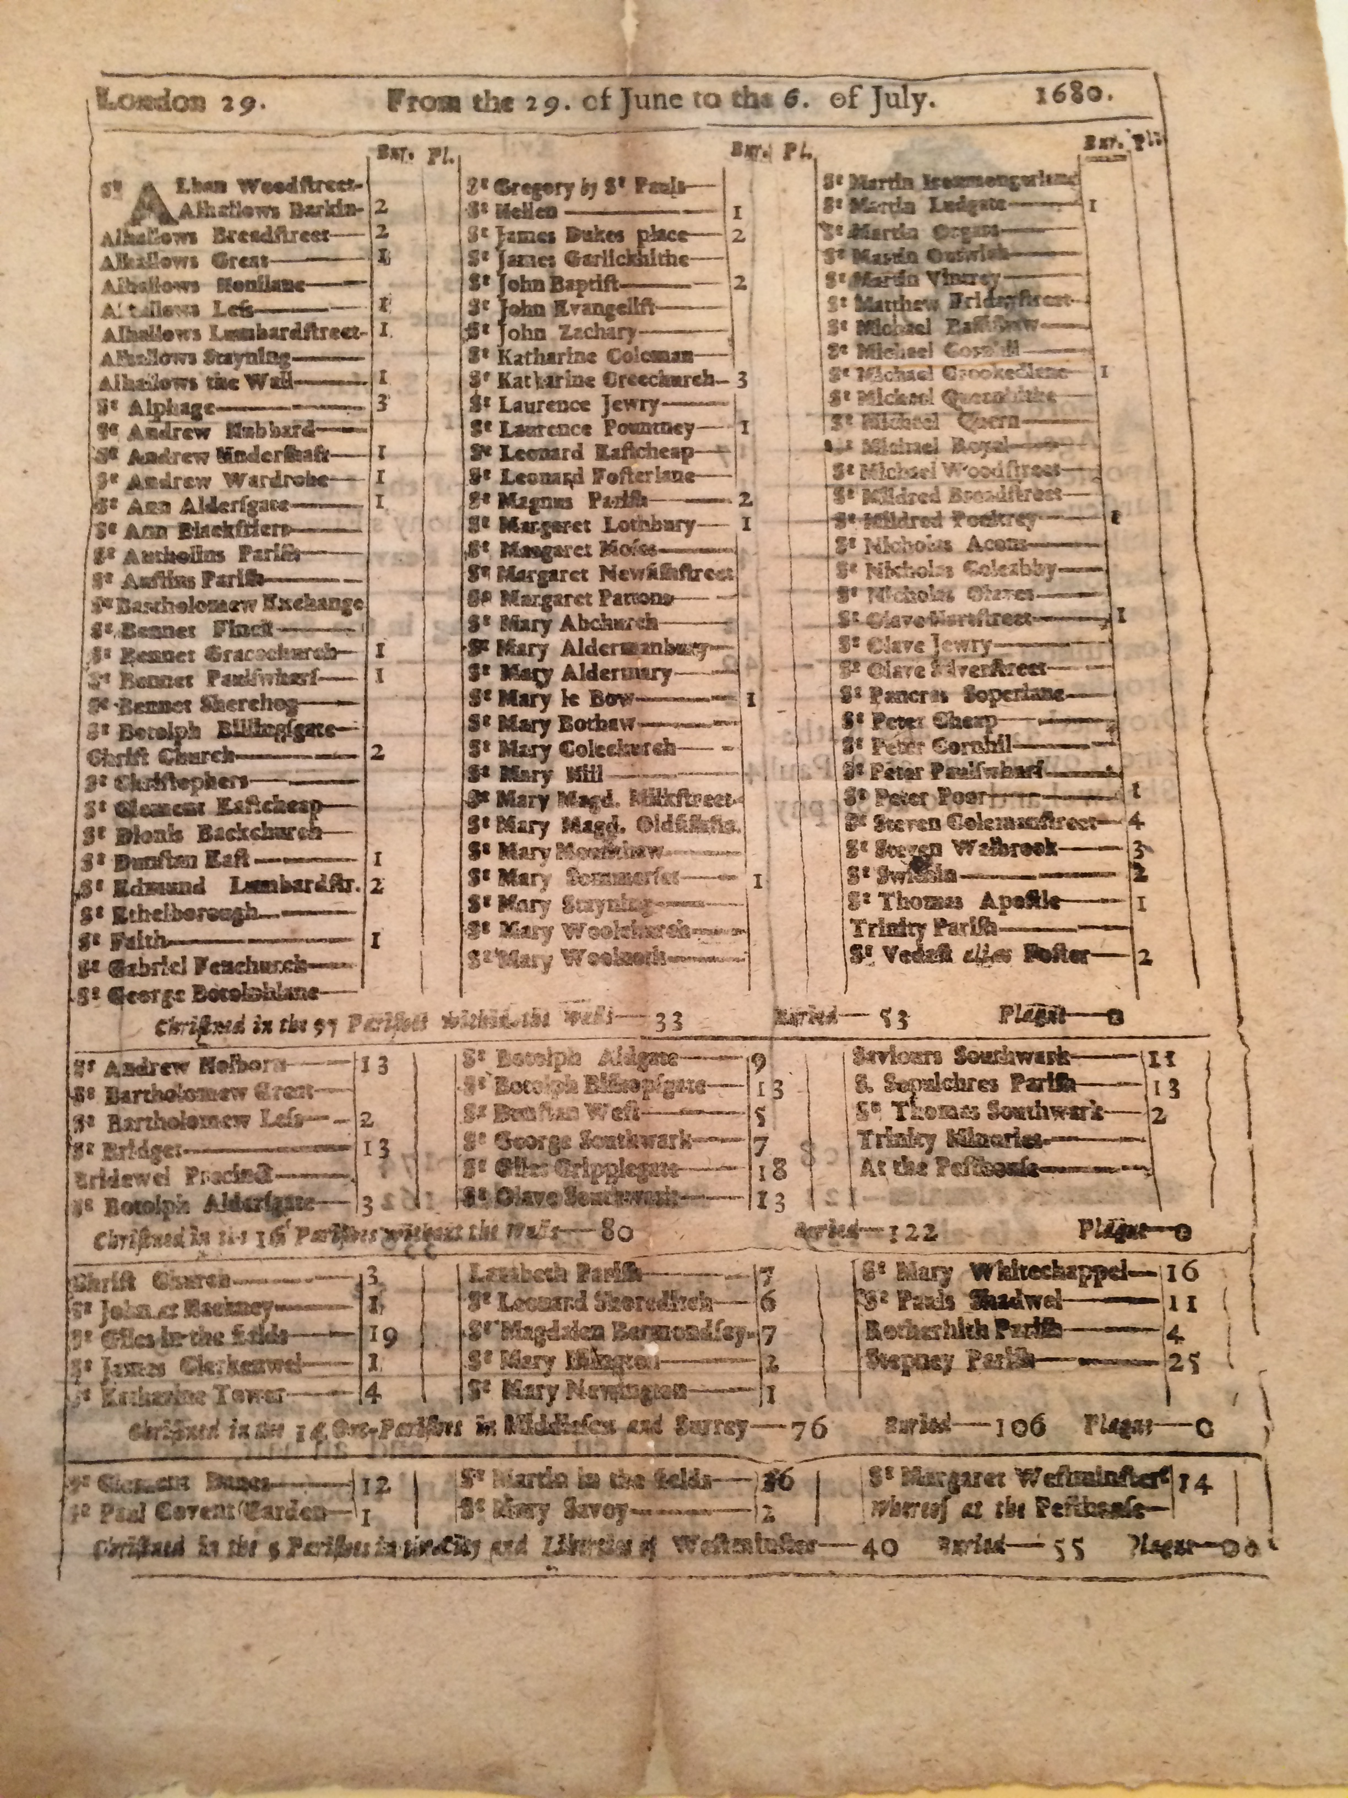
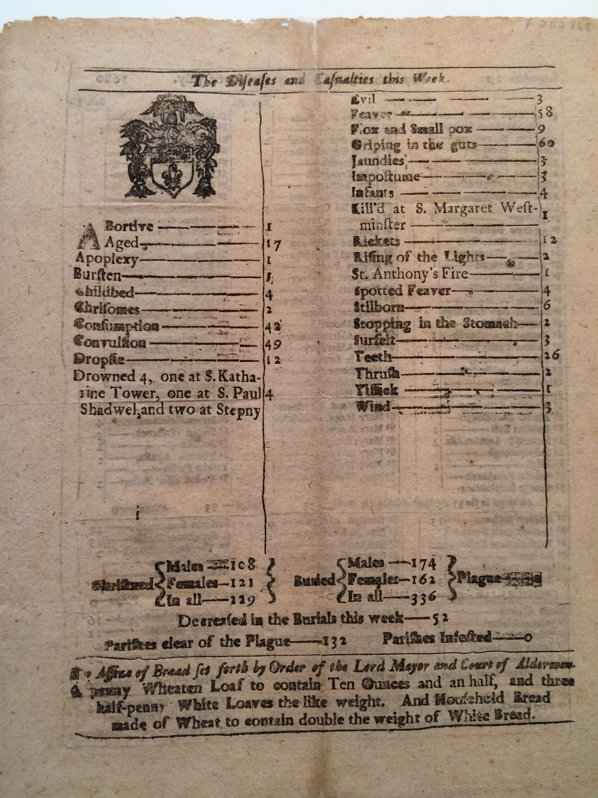
Standardizing the Weekly Bill
@jotis13

Slide 13
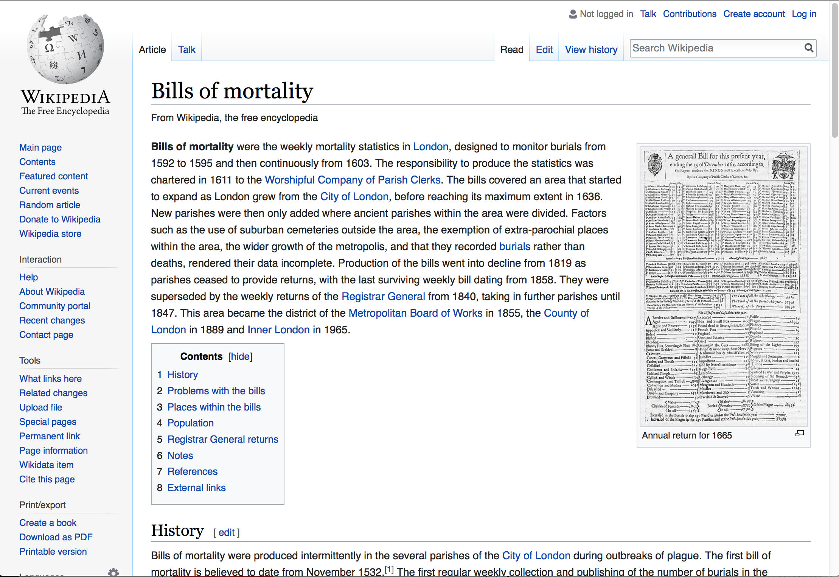
Bills of Mortality in the Internet Age
epidemic years in databases such as EEBO, State Papers Online
late seventeenth & early eighteenth century annual bills in ECCO
select bills in Folger Shakespeare Library’s LUNA Digital Image Collection
@jotis13

Slide 14
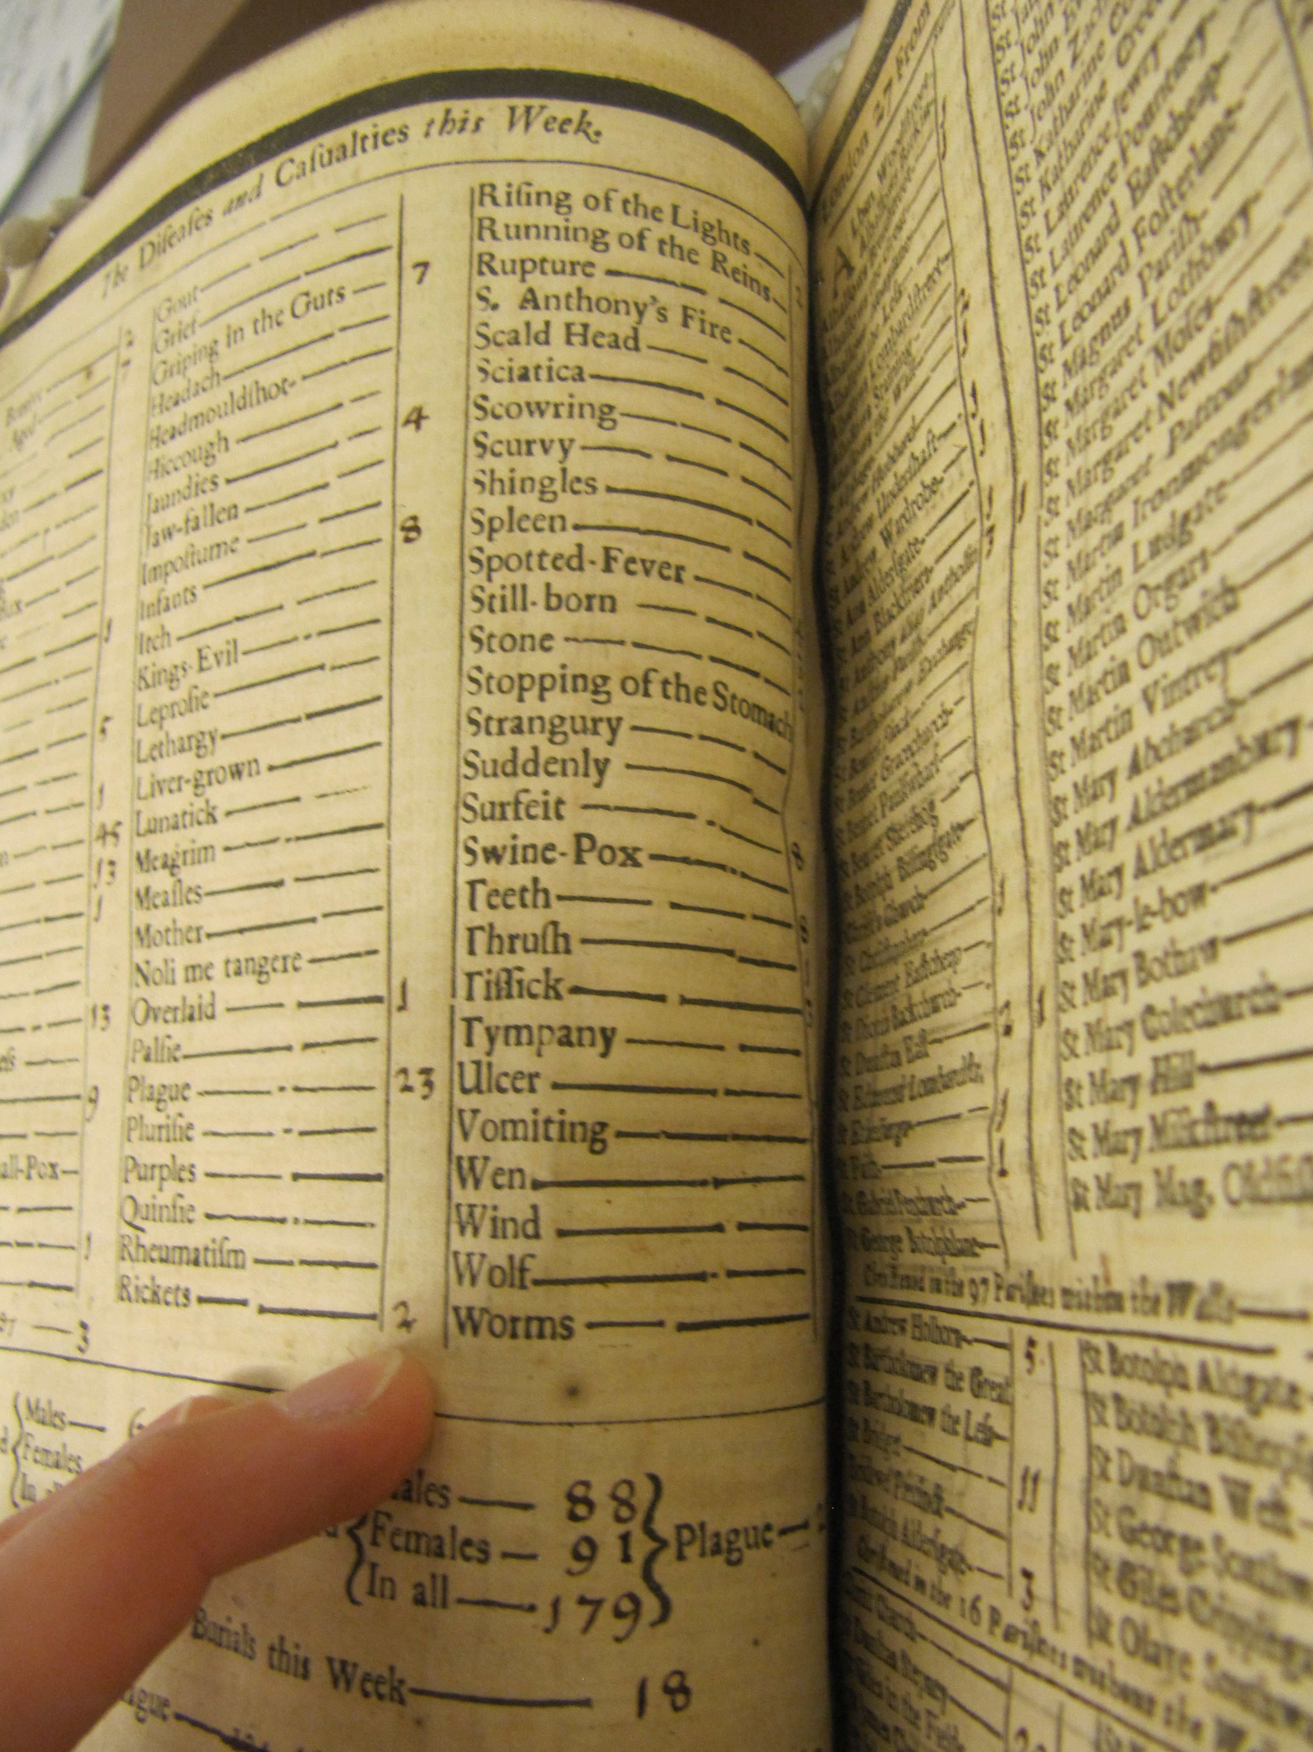
The Data
10,000+ images from the Wellcome Library, Guildhall Library, British Library, and National Archives (Kew, London)
theoretically transcribing all quantitative data
in reality, tight bindings, damaged paper, smeared ink obscure some data
@jotis13

Slide 15
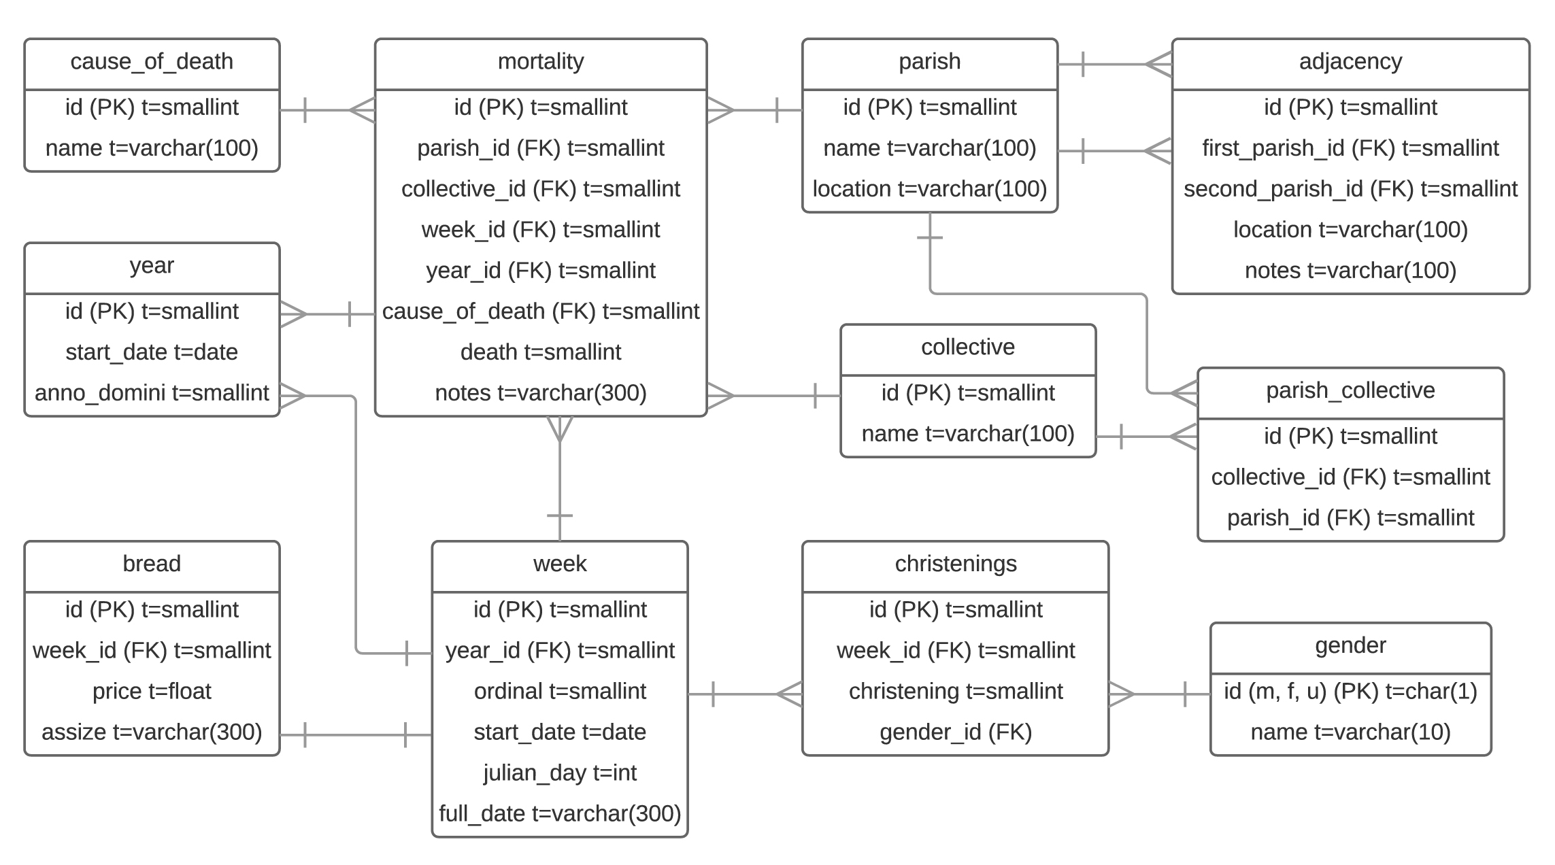
The Database
@jotis13

Slide 16
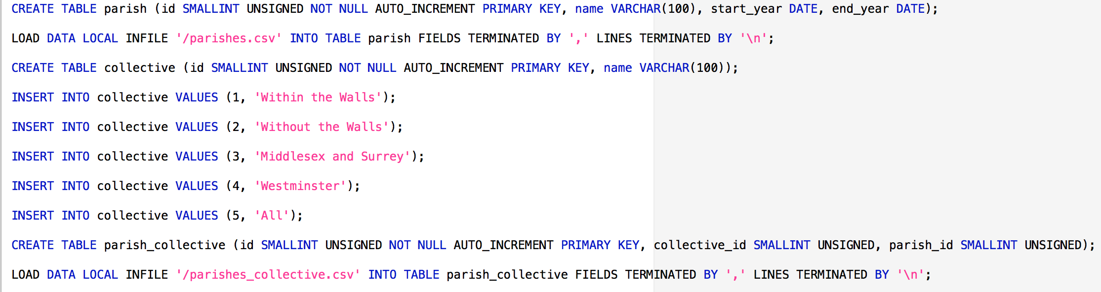
Sharing the Database
@jotis13

Slide 17
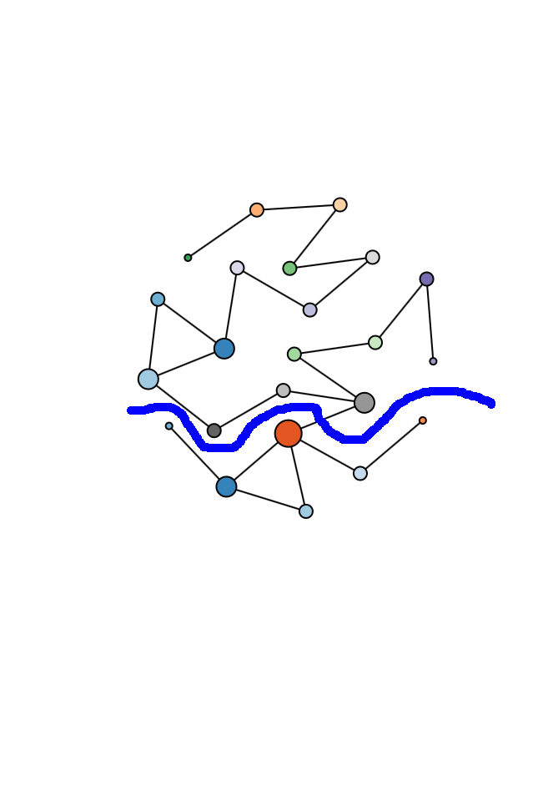
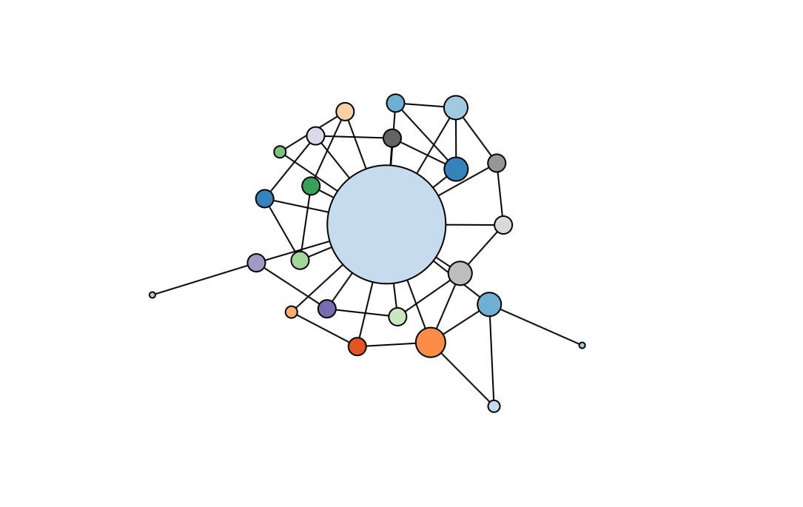
Network Analysis
@jotis13

Slide 18
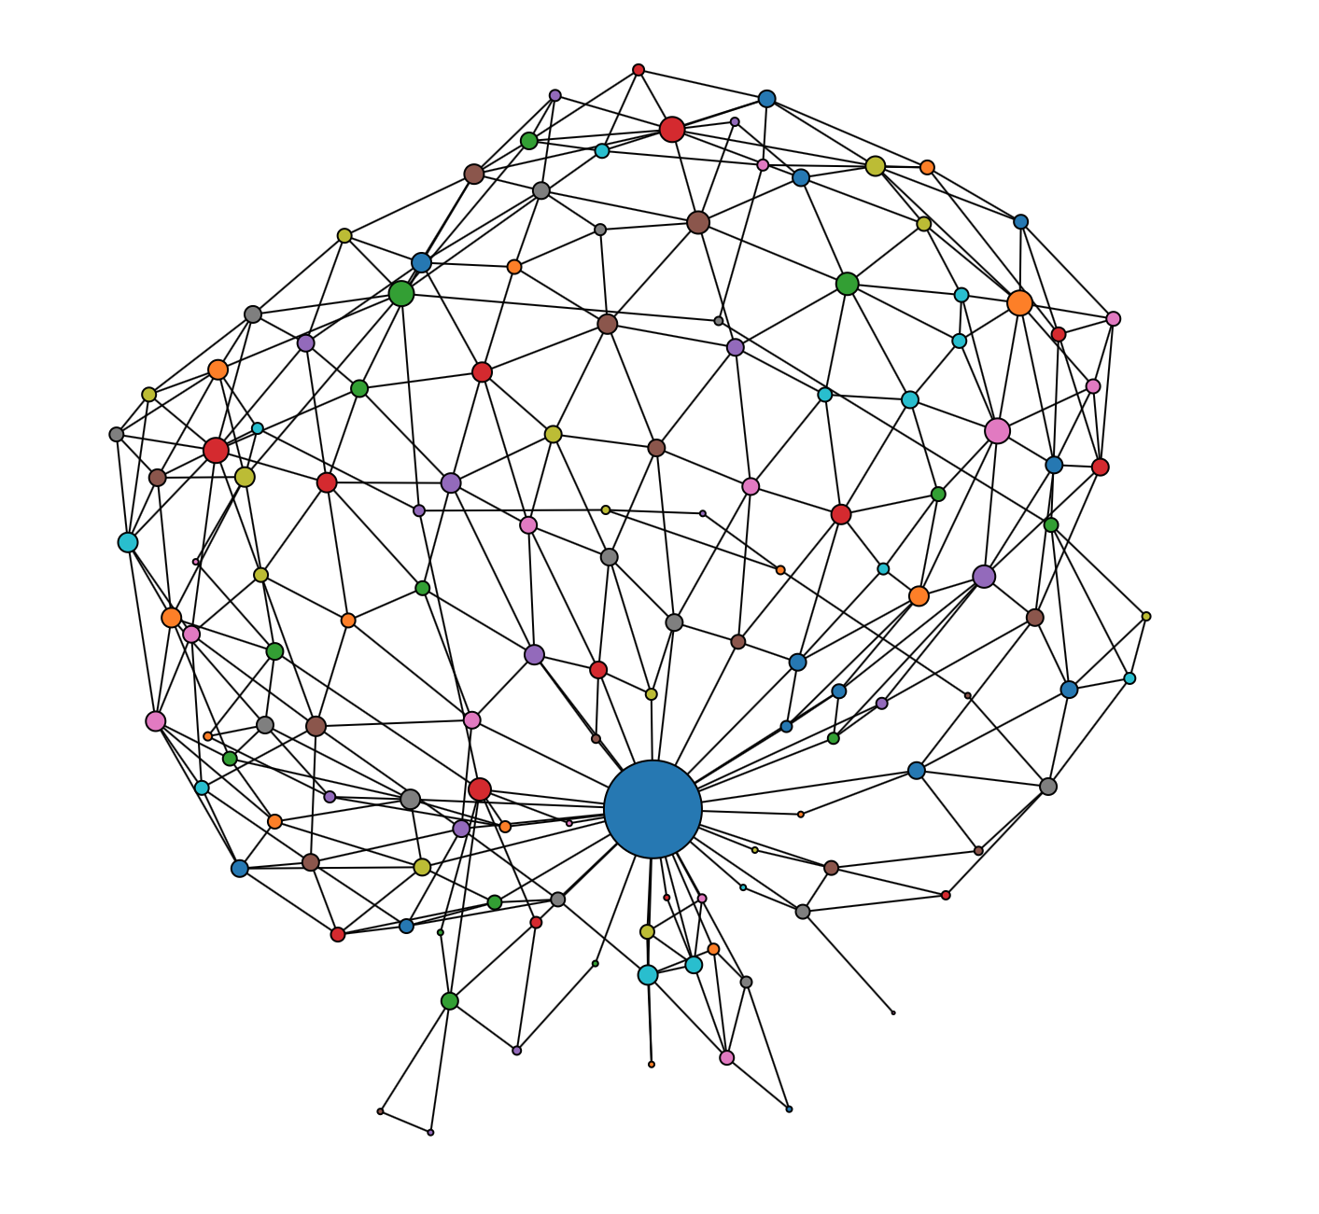
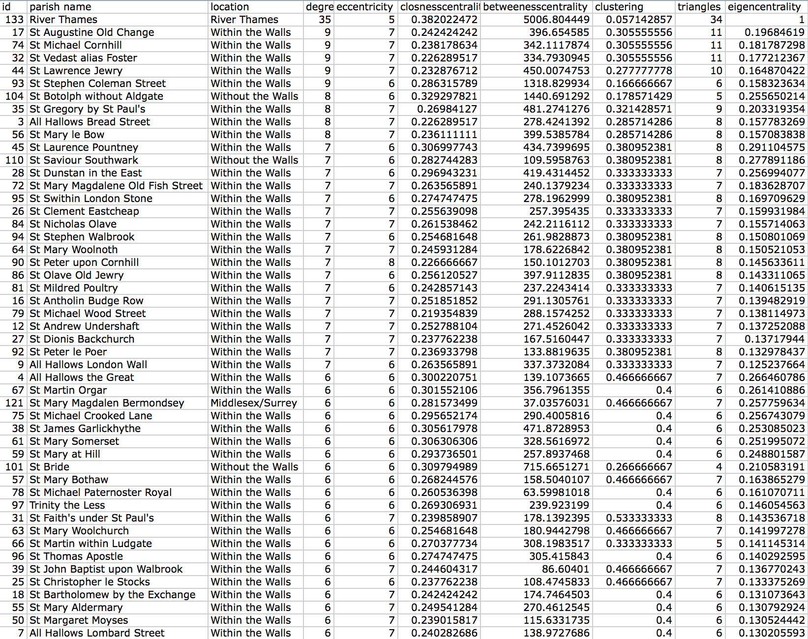
The Network “Within the Bills”
@jotis13

Slide 19
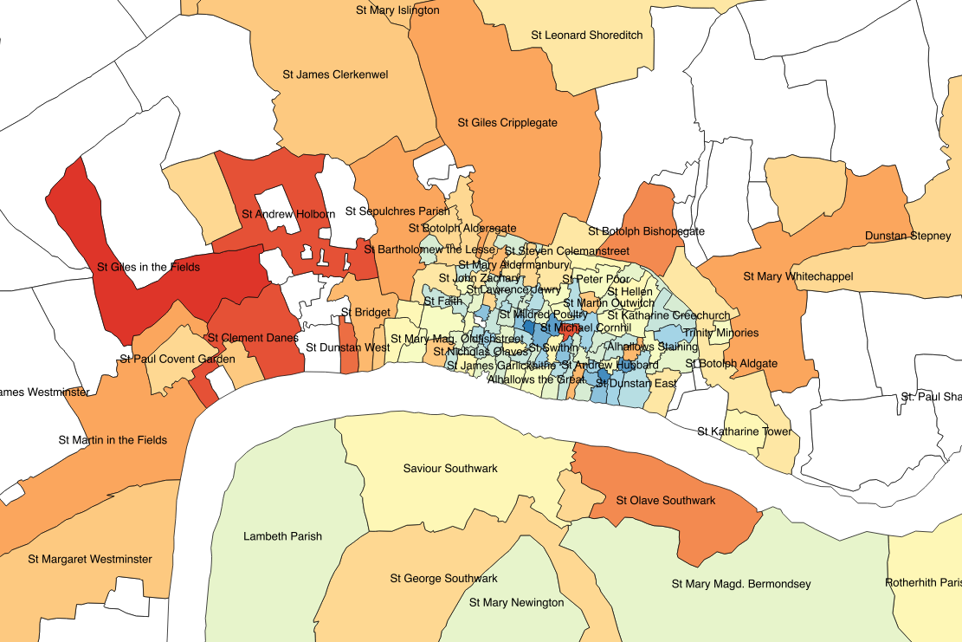
The “1665” Outbreak Begins
@jotis13

Slide 20
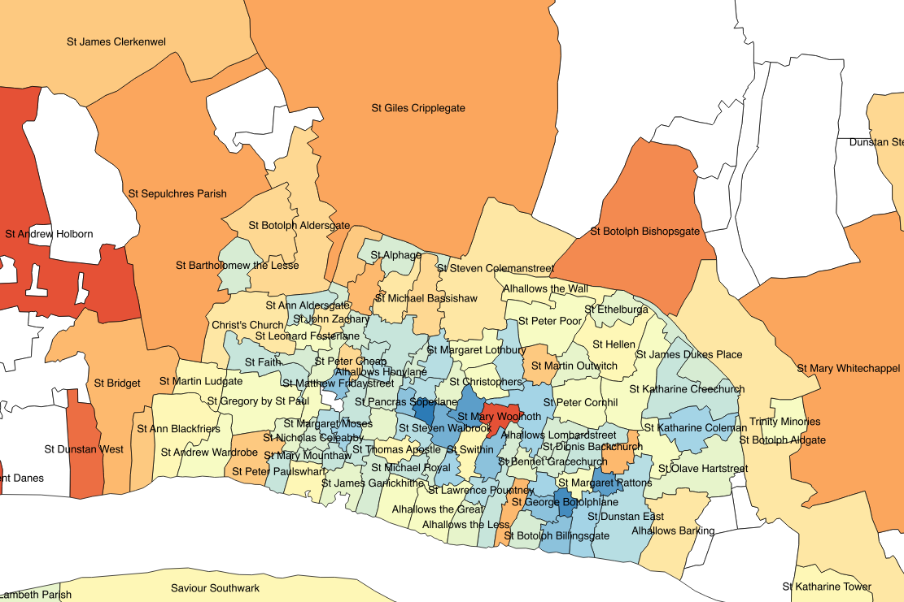
Oddities in the City
@jotis13

Slide 21
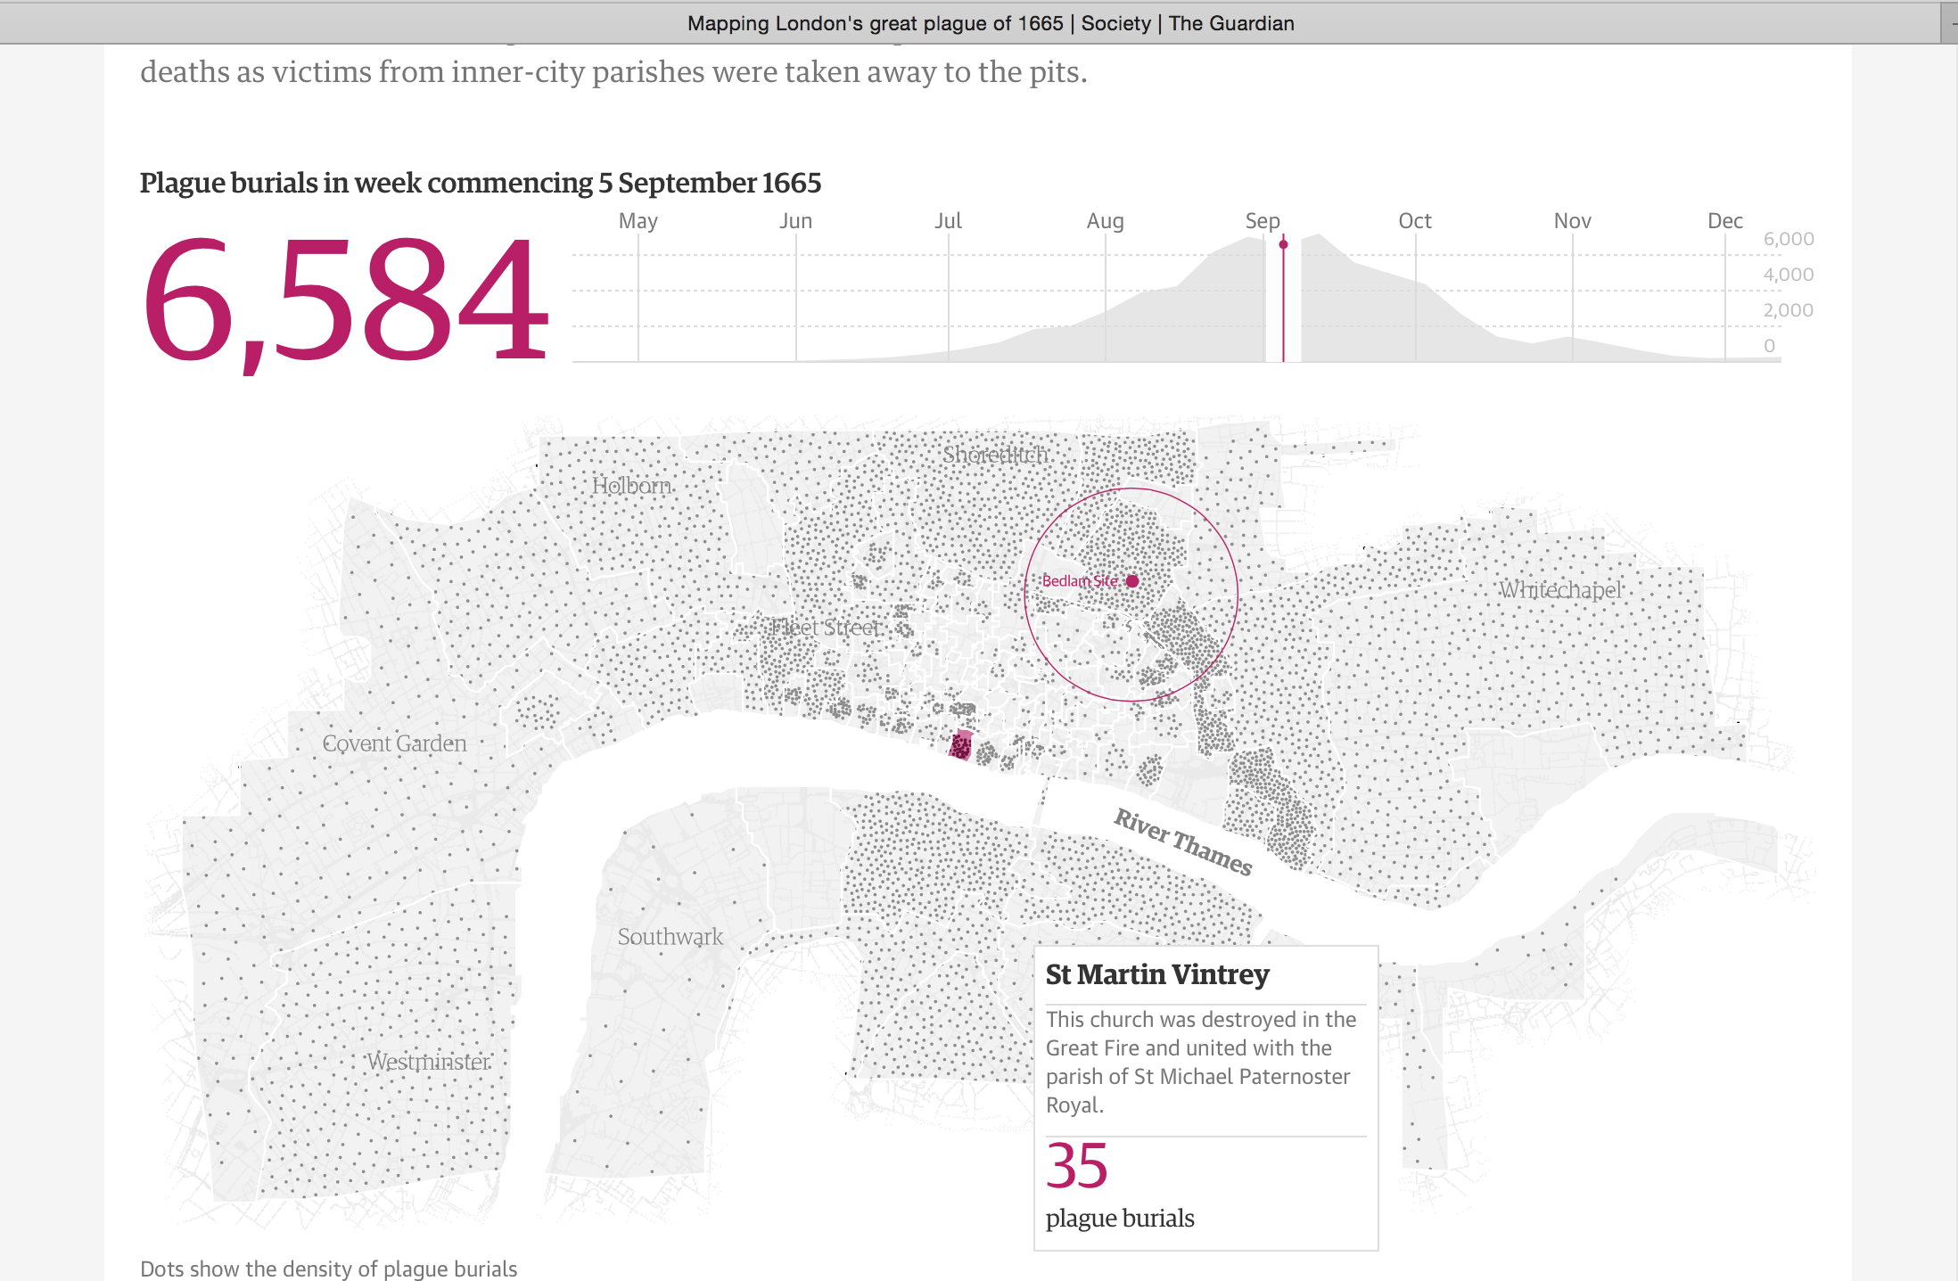
1665 and All That
@jotis13

Slide 22
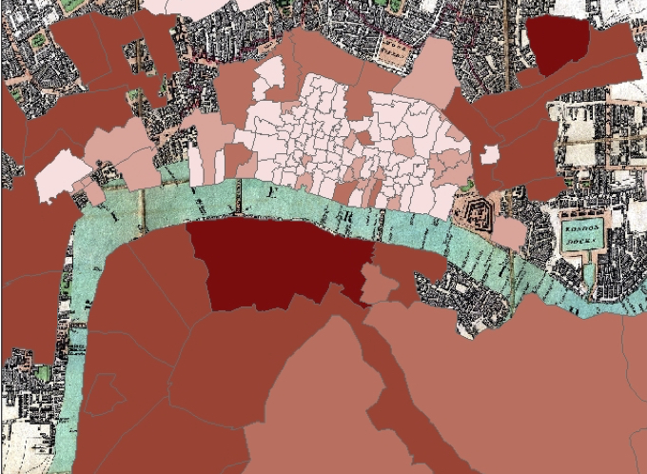
% of Overall Mortality From Plague First Week of 1666
@jotis13

Slide 23
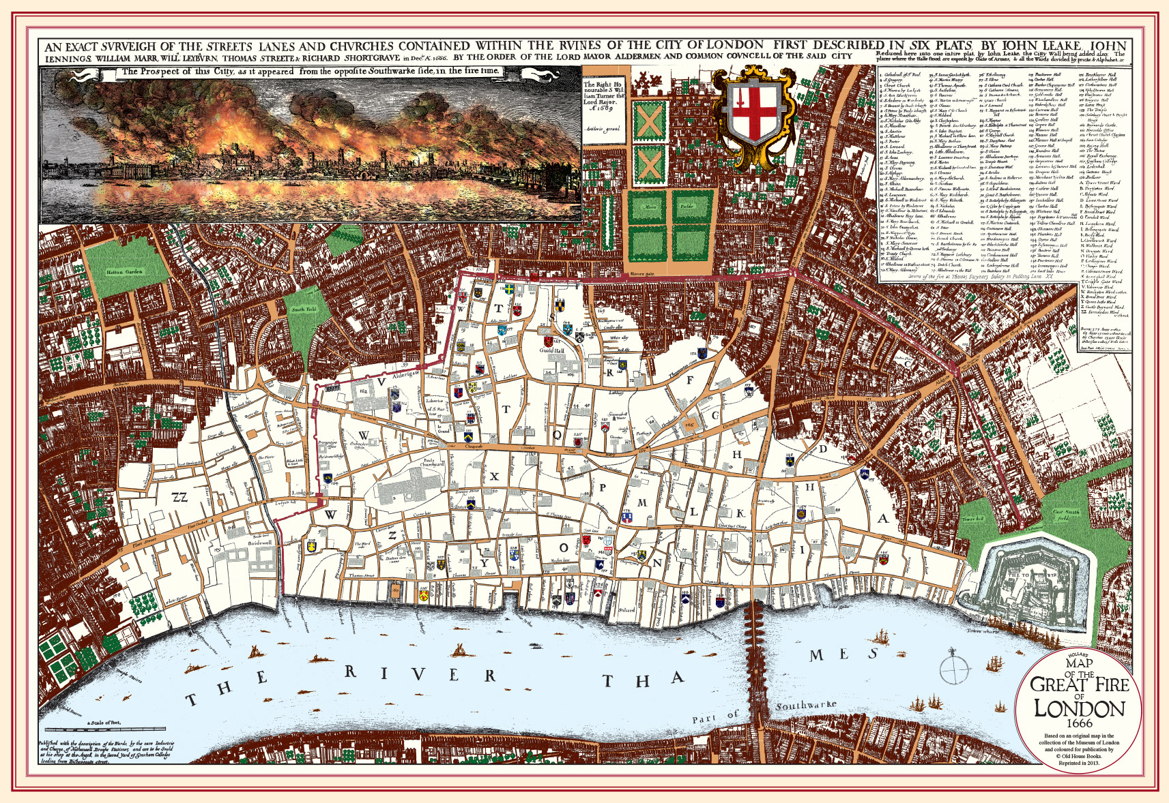
1666 and The Great Fire of London
@jotis13

Slide 24
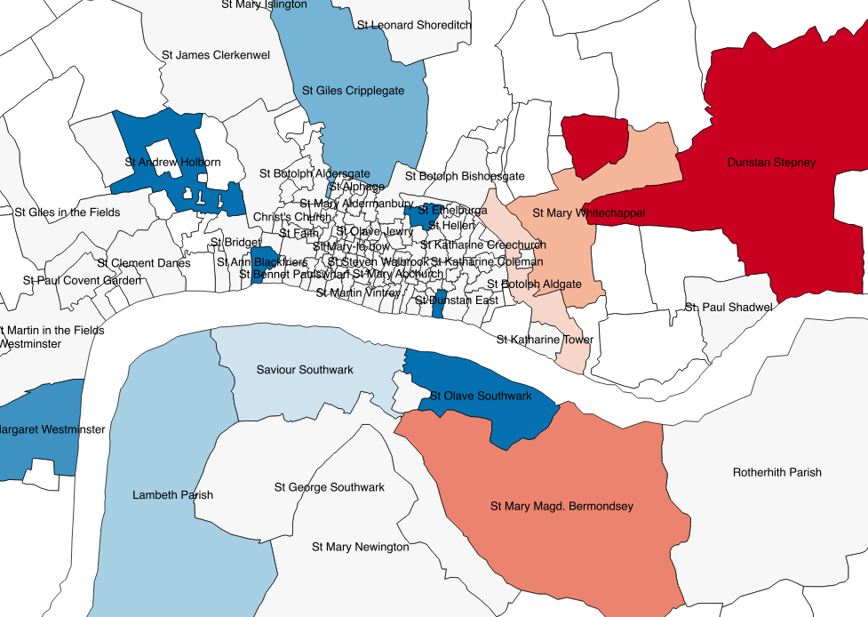
Post-Fire Changes in Plague Mortality
@jotis13

Slide 25
November 20, 1666: “[T]hen to church, it being thanksgiving-day for the cessation of the plague; but, Lord! How the towne do say that it is hastened before the plague is quite over, there dying some people still.” [emphasis mine]
Samuel Pepys, The Diary of Samuel Pepys, eds. Robert Latham and William Matthews (Berkeley: University of California Press, 1972).
@jotis13

Slide 26
The Future of Death by Numbers
https://github.com/jmotis/billsofmortality
first phase
database construction code
initial subset of transcribed bills (annuals, ~10 years)
second phase
shape files for parishes over time
network node/edge tables for mortality over time
third phase
more subsets of transcribed bills (~10 years at a time)
fourth phase
graphical user interface for interacting with database
@jotis13

